Slide 1
MySQL CI/CD
Presentation By Humphrey M. Chinyama

Slide 2
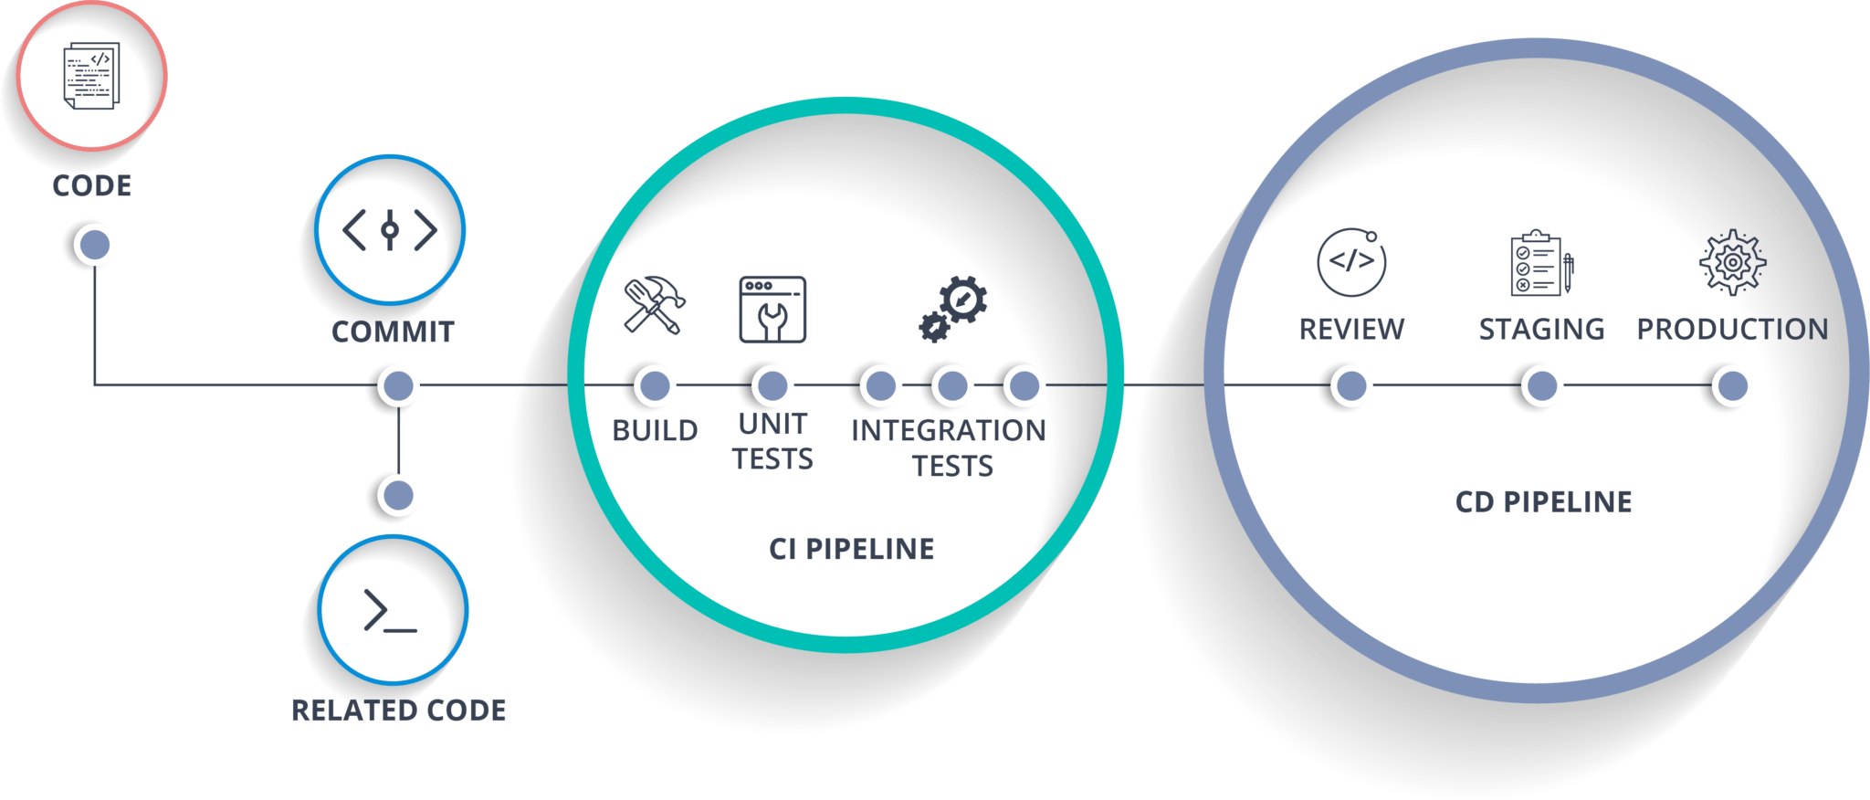
Solution Overview
The following technologies have been used in the development of the solution
Git – for version control
MySQL – RDBMS
Docker – containerization software
Jenkins – automation server
AWS ECS – cloud service that will host solution

Slide 3
Running the Solution
Version Control
Create a Github (sample) repository and create the following structure:-
InitData Folder – store the .sql files (schema.sql & data.sql)
Docker-compose.yml – Docker script file to create container
Host Environment
Create an AWS EC2 account and load docker onto it
CI/CD
Use Jenkins and create scripted pipeline with the following sequence:-
Read files from Github when there is a change
Log onto AWS EC2
Execute docker-compose to load container
(executed docker script is environment aware)

